Slide 1
SQL + POWER BI PORTFOLIO PROJECT | 2026
RETAIL SALES
ANALYSIS
30 SQL Questions • Queries • MySQL Outputs
MySQL Workbench | Power BI Data Model
PRESENTED BY | SATYAM DASH
Database: retail_sales

Slide 2
PROJECT OVERVIEW
From retail transactions to business insights
A business-focused analysis using customers, products and orders to calculate sales KPIs and understand purchasing behaviour.
3
30
50
RELATED TABLES
SQL QUESTIONS
ORDER RECORDS
Customers • Products • Orders
Basics to business cases
Supplied project dataset
REVENUE RULE
Revenue per order line = orders.quantity × products.price
Relationships: Customers[customer_id] → Orders[customer_id] and Products[product_id] → Orders[product_id]. Both are one-to-many relationships.

Slide 3
CONTENTS
Project roadmap
01
DATA VALIDATION & SQL BASICS
Questions 1–5
02
SALES ANALYSIS
Questions 6–12
03
CUSTOMER & PRODUCT ANALYSIS
Questions 13–18
04
ADVANCED SQL
Questions 19–25
05
BUSINESS CASE STUDIES
Questions 26–30

Slide 4



LEVEL 1 • DATA VALIDATION & SQL BASICS
01 | Display the number of records in customers, products, and orders.
SQL QUERY
MYSQL QUERY
SELECT COUNT(*) AS number_of_customers
FROM customers;
SELECT COUNT(*) AS number_of_products
FROM products;
SELECT COUNT(*) AS number_of_orders
FROM orders;
MYSQL WORKBENCH OUTPUT
RETAIL SALES ANALYSIS | PRESENTED BY SATYAM DASH
01 / 30

Slide 5
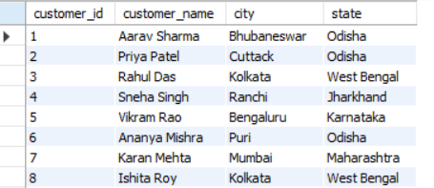
LEVEL 1 • DATA VALIDATION & SQL BASICS
02 | Show all customers, sorted by customer_id.
SQL QUERY
MYSQL QUERY
SELECT *
FROM customers
ORDER BY customer_id ASC;
MYSQL WORKBENCH OUTPUT
RETAIL SALES ANALYSIS | PRESENTED BY SATYAM DASH
02 / 30

Slide 6
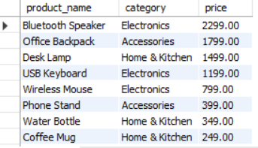
LEVEL 1 • DATA VALIDATION & SQL BASICS
03 | Display product names, categories, and prices from highest to lowest price
SQL QUERY
MYSQL QUERY
SELECT product_name,
category,
price
FROM products
ORDER BY price DESC;
MYSQL WORKBENCH OUTPUT
RETAIL SALES ANALYSIS | PRESENTED BY SATYAM DASH
03 / 30

Slide 7
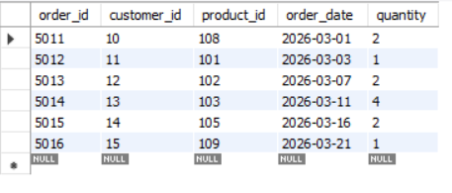
LEVEL 1 • DATA VALIDATION & SQL BASICS
04 | List all orders placed during March 2026.
SQL QUERY
MYSQL QUERY
SELECT *
FROM orders
WHERE order_date>='2026-03-01'
AND order_date<'2026-04-01';
MYSQL WORKBENCH OUTPUT
RETAIL SALES ANALYSIS | PRESENTED BY SATYAM DASH
04 / 30

Slide 8



LEVEL 1 • DATA VALIDATION & SQL BASICS
05 | Find orders where quantity is zero or negative, and check whether any customer or product references are missing
SQL QUERY
MYSQL QUERY
SELECT *
FROM orders
WHERE quantity <= 0 OR quantity IS NULL;
-- Check missing customer references
SELECT o.*
FROM orders o
LEFT JOIN customers c
ON o.customer_id = c.customer_id
WHERE c.customer_id IS NULL;
-- Check missing product references
SELECT o.*
FROM orders o
LEFT JOIN products p
ON o.product_id = p.product_id
WHERE p.product_id IS NULL;
MYSQL WORKBENCH OUTPUT
RETAIL SALES ANALYSIS | PRESENTED BY SATYAM DASH
05 / 30

Slide 9

LEVEL 2 • SALES ANALYSIS
06 | Calculate total revenue across all orders. Revenue per order line = quantity × product price.
SQL QUERY
MYSQL QUERY
SELECT
SUM(o.quantity*p.price) AS revenue
FROM orders o
INNER JOIN products p
ON o.product_id = p.product_id;
MYSQL WORKBENCH OUTPUT
RETAIL SALES ANALYSIS | PRESENTED BY SATYAM DASH
06 / 30

Slide 10

LEVEL 2 • SALES ANALYSIS
07 | Find the total quantity of products sold.
SQL QUERY
MYSQL QUERY
SELECT SUM(o.quantity) AS total_quantity
FROM products p
INNER JOIN
orders o
ON p.product_id = o.product_id;
MYSQL WORKBENCH OUTPUT
RETAIL SALES ANALYSIS | PRESENTED BY SATYAM DASH
07 / 30

Slide 11
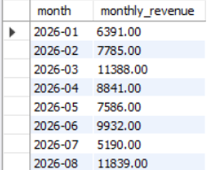
LEVEL 2 • SALES ANALYSIS
08 | Display monthly revenue in chronological order.
SQL QUERY
MYSQL QUERY
SELECT DATE_FORMAT(o.order_date,'%Y-%m')AS month,
SUM(o.quantity*p.price) AS monthly_revenue
FROM orders o
INNER JOIN
products p
ON o.product_id = p.product_id
GROUP BY DATE_FORMAT(o.order_date,'%Y-%m')
ORDER BY month ASC;
MYSQL WORKBENCH OUTPUT
RETAIL SALES ANALYSIS | PRESENTED BY SATYAM DASH
08 / 30

Slide 12
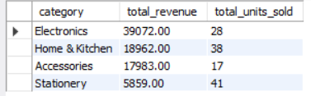
LEVEL 2 • SALES ANALYSIS
09 | Show total revenue and units sold for each category.
SQL QUERY
MYSQL QUERY
SELECT p.category,
SUM(o.quantity*p.price) AS total_revenue,
SUM(o.quantity) AS total_units_sold
FROM orders o
INNER JOIN
products p
ON o.product_id = p.product_id
GROUP BY p.category
ORDER BY total_revenue DESC;
MYSQL WORKBENCH OUTPUT
RETAIL SALES ANALYSIS | PRESENTED BY SATYAM DASH
09 / 30

Slide 13
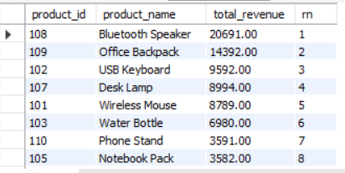
LEVEL 2 • SALES ANALYSIS
10 | Rank products by total revenue, from highest to lowest.
SQL QUERY
MYSQL QUERY
WITH CTE_Product_Revenue AS (
SELECT p.product_id, p.product_name,
SUM(o.quantity*p.price) AS total_revenue
FROM products p
INNER JOIN
orders o
ON p.product_id = o.product_id
GROUP BY p.product_name,p.product_id
),
CTE_Product_Ranking AS (
SELECT product_id ,product_name,
total_revenue,
DENSE_RANK() OVER( ORDER BY total_revenue DESC) AS rn
FROM CTE_Product_Revenue
)
SELECT product_id,product_name,
total_revenue,
rn
FROM CTE_Product_Ranking
ORDER BY total_revenue DESC;
MYSQL WORKBENCH OUTPUT
RETAIL SALES ANALYSIS | PRESENTED BY SATYAM DASH
10 / 30

Slide 14

LEVEL 2 • SALES ANALYSIS
11 | Calculate the average revenue per order line.
SQL QUERY
MYSQL QUERY
SELECT AVG(o.quantity*p.price) AS average_revenue
FROM orders o
INNER JOIN
products p
ON o.product_id = p.product_id;
MYSQL WORKBENCH OUTPUT
RETAIL SALES ANALYSIS | PRESENTED BY SATYAM DASH
11 / 30

Slide 15

LEVEL 2 • SALES ANALYSIS
12 | Identify the month with the highest total revenue
SQL QUERY
MYSQL QUERY
WITH CTE_Monthly_Revenue AS (
SELECT DATE_FORMAT(o.order_date,'%Y-%m') AS month,
SUM(o.quantity*p.price) AS total_revenue
FROM orders o
INNER JOIN
products p
ON o.product_id = p.product_id
GROUP BY DATE_FORMAT(o.order_date,'%Y-%m')
),
CTE_Best_Sales_Month AS (
SELECT month,
total_revenue,
DENSE_RANK() OVER(ORDER BY total_revenue DESC) AS rn
FROM CTE_Monthly_Revenue
)
SELECT month,
total_revenue,
rn
FROM CTE_Best_Sales_Month
WHERE rn = 1;
MYSQL WORKBENCH OUTPUT
RETAIL SALES ANALYSIS | PRESENTED BY SATYAM DASH
12 / 30

Slide 16
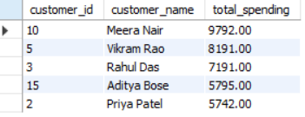
LEVEL 3 • CUSTOMER & PRODUCT ANALYSIS
13 | Display the five customers with the highest total spending.
SQL QUERY
MYSQL QUERY
WITH CTE_Customer_Spending AS (
SELECT c.customer_id,
c.customer_name,
SUM(o.quantity*p.price) AS total_spending
FROM customers c
INNER JOIN
orders o
ON c.customer_id = o.customer_id
INNER JOIN
products p
ON o.product_id = p.product_id
GROUP BY c.customer_id,
c.customer_name
),
CTE_Top_Customers AS (
SELECT customer_id,
customer_name,
total_spending,
DENSE_RANK() OVER(ORDER BY total_spending DESC) AS rn
FROM CTE_Customer_Spending
)
SELECT customer_id,
customer_name,
total_spending
FROM CTE_Top_Customers
WHERE rn<=5
ORDER BY total_spending DESC;
MYSQL WORKBENCH OUTPUT
RETAIL SALES ANALYSIS | PRESENTED BY SATYAM DASH
13 / 30

Slide 17
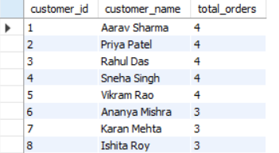
LEVEL 3 • CUSTOMER & PRODUCT ANALYSIS
14 | Find customers who placed more than one order.
SQL QUERY
MYSQL QUERY
SELECT c.customer_id,
c.customer_name,
COUNT(o.order_id) AS total_orders
FROM customers c
INNER JOIN
orders o
ON c.customer_id = o.customer_id
GROUP BY c.customer_id,
c.customer_name
HAVING COUNT(o.order_id)>1
ORDER BY total_orders DESC;
MYSQL WORKBENCH OUTPUT
RETAIL SALES ANALYSIS | PRESENTED BY SATYAM DASH
14 / 30

Slide 18
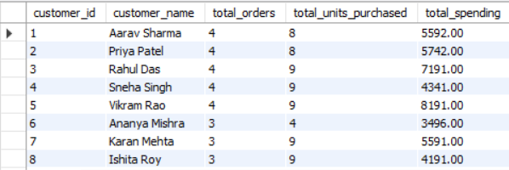
LEVEL 3 • CUSTOMER & PRODUCT ANALYSIS
15 | For every customer, show order count, total units purchased, and total spending, including customers with no orders.
SQL QUERY
MYSQL QUERY
SELECT
c.customer_id,
c.customer_name,
COUNT(DISTINCT o.order_id) AS total_orders,
COALESCE(SUM(o.quantity), 0) AS total_units_purchased,
COALESCE(SUM(o.quantity * p.price), 0) AS total_spending
FROM customers c
LEFT JOIN orders o
ON c.customer_id = o.customer_id
LEFT JOIN products p
ON o.product_id = p.product_id
GROUP BY
c.customer_id,
c.customer_name
ORDER BY c.customer_id;
MYSQL WORKBENCH OUTPUT
RETAIL SALES ANALYSIS | PRESENTED BY SATYAM DASH
15 / 30

Slide 19

LEVEL 3 • CUSTOMER & PRODUCT ANALYSIS
16 | Identify the product or products with the highest total units sold.
SQL QUERY
MYSQL QUERY
WITH CTE_Product_Units_Sold AS (
SELECT p.product_id,
p.product_name,
SUM(o.quantity) AS total_units_sold
FROM products p
INNER JOIN
orders o
ON p.product_id = o.product_id
GROUP BY p.product_id,
p.product_name
),
CTE_Best_Selling_Product AS (
SELECT product_id,
product_name,
total_units_sold,
RANK() OVER(ORDER BY total_units_sold DESC) AS rn
FROM CTE_Product_Units_Sold
)
SELECT product_id,
product_name,
total_units_sold
FROM CTE_Best_Selling_Product
WHERE rn = 1;
MYSQL WORKBENCH OUTPUT
RETAIL SALES ANALYSIS | PRESENTED BY SATYAM DASH
16 / 30

Slide 20
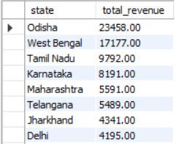
LEVEL 3 • CUSTOMER & PRODUCT ANALYSIS
17 | Calculate total revenue for each customer state.
SQL QUERY
MYSQL QUERY
SELECT c.state,
SUM(o.quantity*p.price) AS total_revenue
FROM customers c
INNER JOIN
orders o
ON c.customer_id = o.customer_id
INNER JOIN
products p
ON o.product_id = p.product_id
GROUP BY c.state
ORDER BY total_revenue DESC;
MYSQL WORKBENCH OUTPUT
RETAIL SALES ANALYSIS | PRESENTED BY SATYAM DASH
17 / 30

Slide 21

LEVEL 3 • CUSTOMER & PRODUCT ANALYSIS
18 | Find products that have no matching records in the orders table
SQL QUERY
MYSQL QUERY
SELECT p.product_id,
p.product_name
FROM products p
LEFT JOIN
orders o
ON p.product_id = o.product_id
WHERE o.order_id IS NULL;
MYSQL WORKBENCH OUTPUT
RETAIL SALES ANALYSIS | PRESENTED BY SATYAM DASH
18 / 30

Slide 22
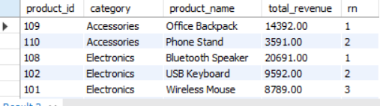
LEVEL 4 • ADVANCED SQL
19 | Rank products by revenue within each category using a window function.
SQL QUERY
MYSQL QUERY
WITH CTE_Product_Revenue AS (
SELECT p.product_id,
p.category,
p.product_name,
SUM(o.quantity * p.price) AS total_revenue
FROM products p
INNER JOIN orders o
ON p.product_id = o.product_id
GROUP BY p.product_id, p.category, p.product_name
),
CTE_Category_Product_Ranking AS (
SELECT product_id,
category,
product_name,
total_revenue,
RANK() OVER (
PARTITION BY category
ORDER BY total_revenue DESC
) AS rn
FROM CTE_Product_Revenue
)
SELECT product_id,
category,
product_name,
total_revenue,
rn
FROM CTE_Category_Product_Ranking
ORDER BY category, rn;
MYSQL WORKBENCH OUTPUT
RETAIL SALES ANALYSIS | PRESENTED BY SATYAM DASH
19 / 30

Slide 23
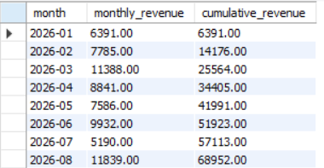
LEVEL 4 • ADVANCED SQL
20 | Show monthly revenue and cumulative revenue over time.
SQL QUERY
MYSQL QUERY
WITH CTE_monthly_revenue AS (
SELECT DATE_FORMAT(o.order_date,'%Y-%m') AS month,
SUM(o.quantity*p.price) AS monthly_revenue
FROM orders o
INNER JOIN
products p
ON o.product_id = p.product_id
GROUP BY DATE_FORMAT(o.order_date,'%Y-%m')
)
SELECT month,
monthly_revenue,
SUM(monthly_revenue) OVER(ORDER BY month ASC) AS cumulative_revenue
FROM CTE_monthly_revenue
ORDER BY month ASC;
MYSQL WORKBENCH OUTPUT
RETAIL SALES ANALYSIS | PRESENTED BY SATYAM DASH
20 / 30

Slide 24
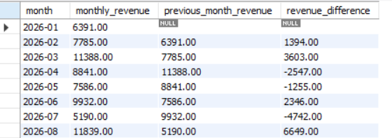
LEVEL 4 • ADVANCED SQL
21 | For each month, show revenue, previous month's revenue, and the difference.
SQL QUERY
MYSQL QUERY
WITH CTE_mom AS (
SELECT DATE_FORMAT(o.order_date,'%Y-%m') AS month,
SUM(o.quantity*p.price) AS monthly_revenue
FROM orders o
INNER JOIN
products p
ON o.product_id = p.product_id
GROUP BY DATE_FORMAT(o.order_date,'%Y-%m')
),
CTE_previous_month_revenue AS (
SELECT month,
monthly_revenue,
LAG(monthly_revenue) OVER(ORDER BY month ASC) AS previous_month_revenue
FROM CTE_mom
)
SELECT month,
monthly_revenue,
previous_month_revenue,
ROUND((monthly_revenue-previous_month_revenue),2) AS revenue_difference
FROM CTE_previous_month_revenue
ORDER BY month ASC;
MYSQL WORKBENCH OUTPUT
RETAIL SALES ANALYSIS | PRESENTED BY SATYAM DASH
21 / 30

Slide 25
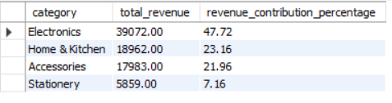
LEVEL 4 • ADVANCED SQL
22 | Calculate each product category's percentage of total revenue.
SQL QUERY
MYSQL QUERY
WITH CTE_revenue_contribution AS (
SELECT p.category,
SUM(o.quantity*p.price) AS total_revenue
FROM products p
INNER JOIN
orders o
ON p.product_id = o.product_id
GROUP BY p.category
)
SELECT category,
total_revenue,
ROUND(100.0*total_revenue/SUM(total_revenue) OVER(),2) AS revenue_contribution_percentage
FROM CTE_revenue_contribution
ORDER BY revenue_contribution_percentage DESC;
MYSQL WORKBENCH OUTPUT
RETAIL SALES ANALYSIS | PRESENTED BY SATYAM DASH
22 / 30

Slide 26

LEVEL 4 • ADVANCED SQL
23 | Find the product with the second-highest total revenue; handle ties appropriately.
SQL QUERY
MYSQL QUERY
WITH CTE_second_highest_revenue AS (
SELECT p.product_id,
p.product_name,
SUM(o.quantity*p.price) AS total_revenue
FROM products p
INNER JOIN
orders o
ON p.product_id =o.product_id
GROUP BY
p.product_id,
p.product_name
),
CTE_rank AS (
SELECT product_id,
product_name,
total_revenue,
DENSE_RANK() OVER(ORDER BY total_revenue DESC) AS rn
FROM CTE_second_highest_revenue
)
SELECT product_id,
product_name,
total_revenue
FROM CTE_rank
WHERE rn = 2;
MYSQL WORKBENCH OUTPUT
RETAIL SALES ANALYSIS | PRESENTED BY SATYAM DASH
23 / 30

Slide 27
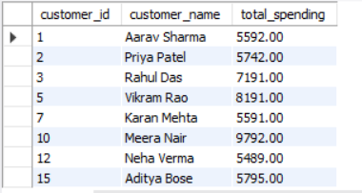
LEVEL 4 • ADVANCED SQL
24 | Find customers whose total spending is greater than the average customer spending.
SQL QUERY
MYSQL QUERY
WITH CTE_Customer_Spending AS (
SELECT c.customer_id,
c.customer_name,
COALESCE(SUM(o.quantity*p.price),0)AS total_spending
FROM customers c
LEFT JOIN
orders o
ON c.customer_id = o.customer_id
LEFT JOIN
products p
ON o.product_id = p.product_id
GROUP BY
c.customer_id,
c.customer_name
),
CTE_Average_Customer_Spending AS (
SELECT customer_id,
customer_name,
total_spending,
AVG(total_spending) OVER() AS average_total_spending
FROM CTE_Customer_Spending
)
SELECT customer_id,
customer_name,
total_spending
FROM CTE_Average_Customer_Spending
WHERE total_spending>average_total_spending;
MYSQL WORKBENCH OUTPUT
RETAIL SALES ANALYSIS | PRESENTED BY SATYAM DASH
24 / 30

Slide 28
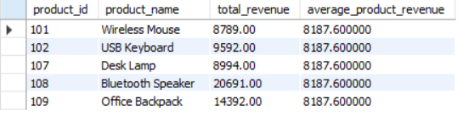
LEVEL 4 • ADVANCED SQL
25 | Use a CTE to calculate revenue per product, then return products whose revenue is above the average product revenue
SQL QUERY
MYSQL QUERY
WITH CTE_revenue_per_product AS (
SELECT p.product_id,
p.product_name,
COALESCE(SUM(o.quantity*p.price),0) AS total_revenue
FROM products p
LEFT JOIN
orders o
ON p.product_id = o.product_id
GROUP BY p.product_id,
p.product_name
),
CTE_avg_product_revenue AS (
SELECT product_id,
product_name,
total_revenue,
AVG(total_revenue) OVER() AS average_product_revenue
FROM CTE_revenue_per_product
)
SELECT product_id,
product_name,
total_revenue,
average_product_revenue
FROM CTE_avg_product_revenue
WHERE total_revenue>average_product_revenue;
MYSQL WORKBENCH OUTPUT
RETAIL SALES ANALYSIS | PRESENTED BY SATYAM DASH
25 / 30

Slide 29
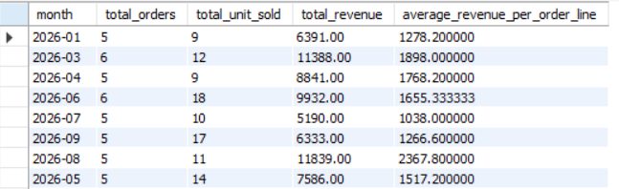
LEVEL 5 • BUSINESS CASE STUDIES
26 | Create a monthly summary containing order count, units sold, revenue, and average revenue per order line.
SQL QUERY
MYSQL QUERY
WITH CTE_monthly_kpi_report AS (
SELECT DATE_FORMAT(o.order_date,'%Y-%m') AS month,
COUNT(o.order_id) AS total_orders,
SUM(o.quantity) AS total_unit_sold,
SUM(o.quantity*p.price) AS total_revenue,
AVG(o.quantity*p.price) AS average_revenue_per_order_line
FROM orders o
INNER JOIN
products p
ON o.product_id = p.product_id
GROUP BY DATE_FORMAT(o.order_date,'%Y-%m')
)
SELECT month,
total_orders,
total_unit_sold,
total_revenue,
average_revenue_per_order_line
FROM CTE_monthly_kpi_report;
MYSQL WORKBENCH OUTPUT
RETAIL SALES ANALYSIS | PRESENTED BY SATYAM DASH
26 / 30

Slide 30
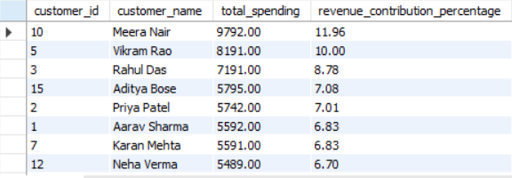
LEVEL 5 • BUSINESS CASE STUDIES
27 | Show each customer's spending and percentage contribution to total revenue.
SQL QUERY
MYSQL QUERY
WITH CTE_revenue_contribution AS (
SELECT c.customer_id,
c.customer_name,
SUM(o.quantity*p.price) AS total_spending
FROM customers c
INNER JOIN
orders o
ON c.customer_id = o.customer_id
INNER JOIN
products p
ON o.product_id = p.product_id
GROUP BY c.customer_id,
c.customer_name
)
SELECT customer_id,
customer_name,
total_spending,
ROUND(100.0*total_spending/SUM(total_spending) OVER(),2) AS revenue_contribution_percentage
FROM CTE_revenue_contribution
ORDER BY total_spending DESC;
MYSQL WORKBENCH OUTPUT
RETAIL SALES ANALYSIS | PRESENTED BY SATYAM DASH
27 / 30

Slide 31
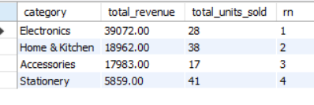
LEVEL 5 • BUSINESS CASE STUDIES
28 | Compare categories by revenue and units sold, and identify the strongest category.
SQL QUERY
MYSQL QUERY
WITH CTE_Category_Performance AS (
SELECT p.category,
SUM(o.quantity * p.price) AS total_revenue,
SUM(o.quantity) AS total_units_sold
FROM products p
INNER JOIN orders o
ON p.product_id = o.product_id
GROUP BY p.category
),
CTE_Ranked AS (
SELECT category,
total_revenue,
total_units_sold,
DENSE_RANK() OVER (
ORDER BY total_revenue DESC
) AS rn
FROM CTE_Category_Performance
)
SELECT category,
total_revenue,
total_units_sold,
rn
FROM CTE_Ranked
ORDER BY rn;
MYSQL WORKBENCH OUTPUT
RETAIL SALES ANALYSIS | PRESENTED BY SATYAM DASH
28 / 30

Slide 32
LEVEL 5 • BUSINESS CASE STUDIES
29 | Create a single result containing total revenue, total units sold, number of orders, number of customers who purchased,
SQL QUERY
MYSQL QUERY
-- and average revenue per order.
SELECT SUM(o.quantity*p.price) AS total_revenue,
SUM(o.quantity) AS total_units_sold,
COUNT(DISTINCT o.order_id) AS total_number_of_orders,
COUNT(DISTINCT c.customer_id) AS number_of_customer,
ROUND(SUM(o.quantity * p.price) / COUNT(DISTINCT o.order_id),2) AS average_revenue_per_order
FROM customers c
INNER JOIN
orders o
ON c.customer_id = o.customer_id
INNER JOIN
products p
ON o.product_id = p.product_id;
MYSQL WORKBENCH OUTPUT
RETAIL SALES ANALYSIS | PRESENTED BY SATYAM DASH
29 / 30

Slide 33
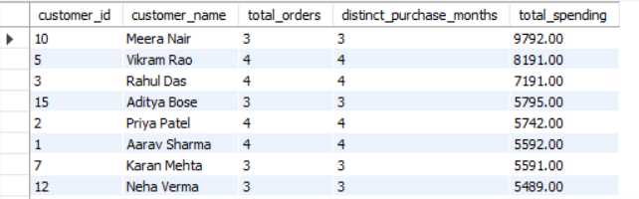
LEVEL 5 • BUSINESS CASE STUDIES
30 | Identify customers who have placed orders in at least 3 different months.
SQL QUERY
MYSQL QUERY
WITH CTE_Customer_Purchase_Analysis AS (
SELECT
c.customer_id,
c.customer_name,
COUNT(DISTINCT o.order_id) AS total_orders,
COUNT(DISTINCT DATE_FORMAT(o.order_date, '%Y-%m')) AS distinct_purchase_months,
SUM(o.quantity * p.price) AS total_spending
FROM customers c
INNER JOIN orders o
ON c.customer_id = o.customer_id
INNER JOIN products p
ON o.product_id = p.product_id
GROUP BY
c.customer_id,
c.customer_name
)
SELECT
customer_id,
customer_name,
total_orders,
distinct_purchase_months,
total_spending
FROM CTE_Customer_Purchase_Analysis
WHERE distinct_purchase_months >= 3
ORDER BY total_spending DESC;
MYSQL WORKBENCH OUTPUT
RETAIL SALES ANALYSIS | PRESENTED BY SATYAM DASH
30 / 30

Slide 34
PROJECT SUMMARY
Turning SQL into
retail business insight
This portfolio demonstrates SQL query writing, data validation, sales analysis, customer analysis, KPI reporting and a Power BI relational data model.
PRESENTED BY | SATYAM DASH

